Slide 1

Mapping Data for Societal Benefit
Created By
Tanay Mathur
Mehek Mathur
Prabhu RC
Ruchir Mathur (Team lead)

Slide 2
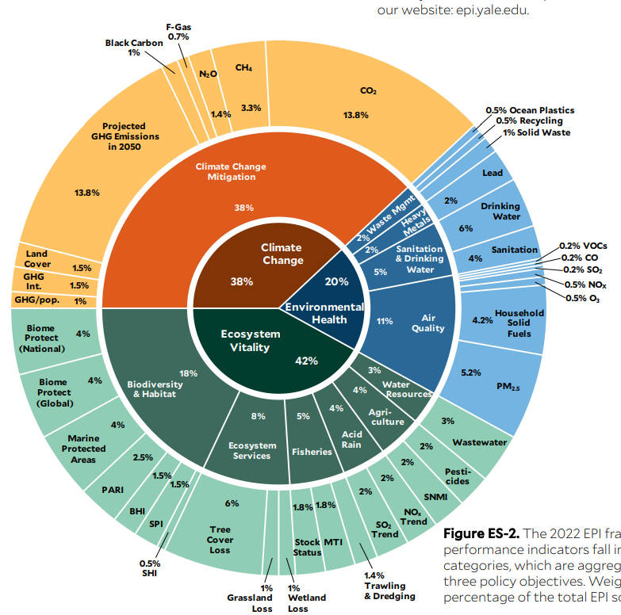
Objectives
Build an Environment Data platform that uses NASA data and create an app that uses the Environment data platform data. We plan to use the Environment Performance data index from NASA for this.
Environment Performance Index
Importance of Environment Performance Index
Environment Performance index provides data that gauges countries on Environment performance
Ranks 180 countries on 40 performance indicators
Ensures that there is governance on the Environment Goals that countries have set up
Detailed EPI performance indicators ensures that there is traction at each level
Country wise data helps governments formulate environment policy

Slide 3
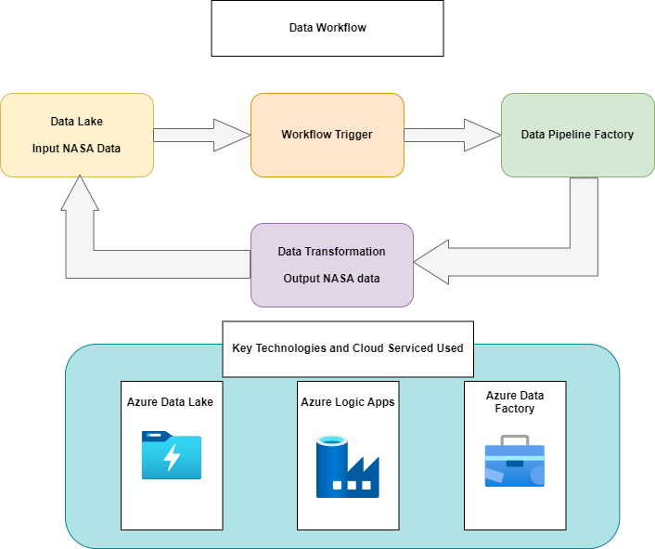
Environment Data Platform Architecture
Key Highlights
NASA Data in the form of CSV file gets loaded into Azure Data Lake
Azure Logic Data Apps checks the availability of the file and triggers the Data Pipeline
Azure Data Pipeline Transforms the Data into JSON
Azure Data Factory outputs the data and stores into Azure Data Lake as JSON
Apps can access JSON data as an API and use it

Slide 4
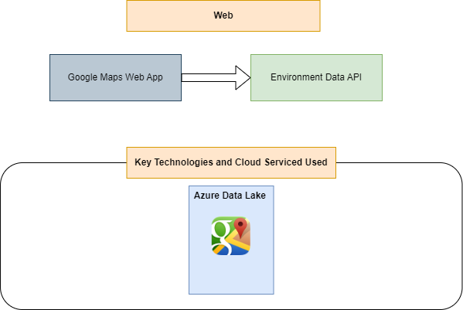
Web App Architecture
Key Highlights
Google Maps based HTML web app shows the Maps data based on the Environment data
Google Maps app creates environment charts and shows it on the map
Google Map app uses JSON data from the Azure Data Lake API
Detailed Country wise data is shown to the users

Slide 5
Key Benefits of the Solution
One Stop Solution for Environment data needs
Consistent Data Platform
Easy Data Loads
Intuitive User Interface
Simple User Interface
Detailed Information available
Available at one place
Users don’t have to navigate much
Rich Map and Chart features
Data can be easily used for Analytics

Slide 6
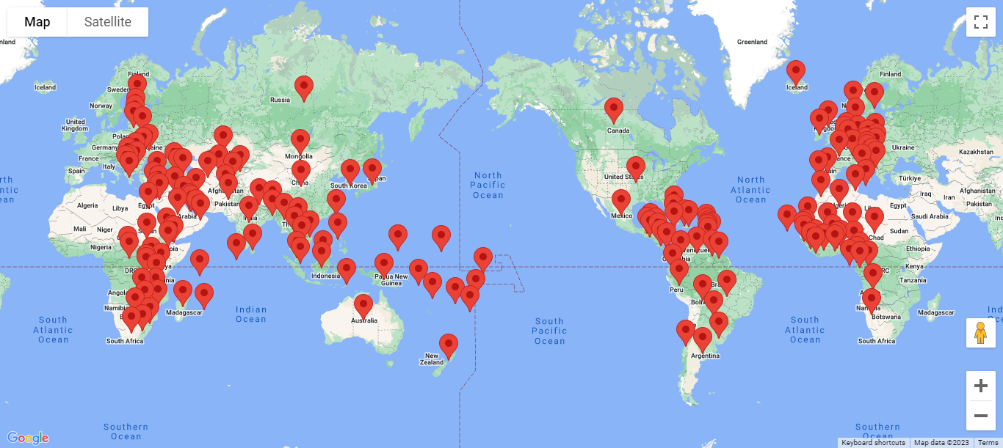
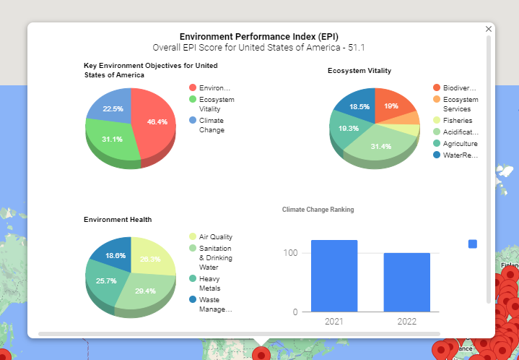
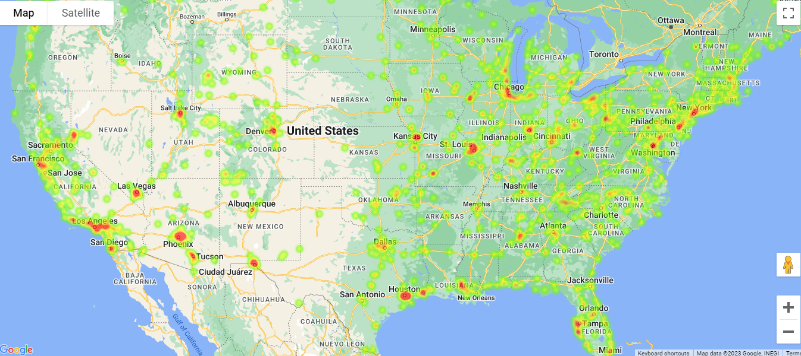
Environment Performance Index Maps
Global Map showing country specific Pins, users can click to get detailed information
Key EPI Indictors after clicking the Pins on the Map
Heatmap of Air Quality Index in the US

Slide 7
Next Steps
Keep building the platform and make a unified platform that all users can use
Make it easily available so that people can build apps on it
Build further maps on key Environment Performance indicators
Integrate the recommendations feature on what users can do to solve the climate change challenges
Mapping Data for Societal Benefit
Key References
EPI Data - https://www.earthdata.nasa.gov/news/new-environmental-performance-index-epi-available-nasas-sedac
NASA Air Quality - https://www.earthdata.nasa.gov/learn/find-data/near-real-time/hazards-and-disasters/air-quality

